Slide 1
Fundamentals of Object-Oriented Programming (OOP)
Notes:
Note from Chuck. If you are using these materials, you can remove the UM logo and replace it with your own, but please retain the CC-BY logo on the first page as well as the acknowledgement page(s) at the end.

Slide 2
Why Learn OOP?
Example: How managing student data at FPT University efficiently ?

Slide 3
Why Learn OOP?
Helps design modular, reusable, and maintainable code.
Widely used in industries like software development, AI, and IoT.
Enhances your ability to model real-world problems programmatically.

Slide 4
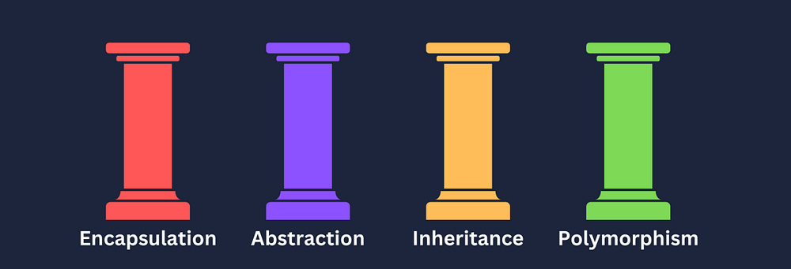
Key Principles of OOP

Slide 5
Key Principles of OOP
Encapsulation: Protecting data by bundling it with methods.
Abstraction: Hiding unnecessary details from the user.
Inheritance: Creating new classes from existing ones.
Polymorphism: Allowing different classes to respond to the same function call.

Slide 6
Real-World Analogy
A class is a blueprint for creating objects.
Example:
Class: Student
Objects: "Nam (AI19b02)"
"Mai (SE22b01)"

Slide 7
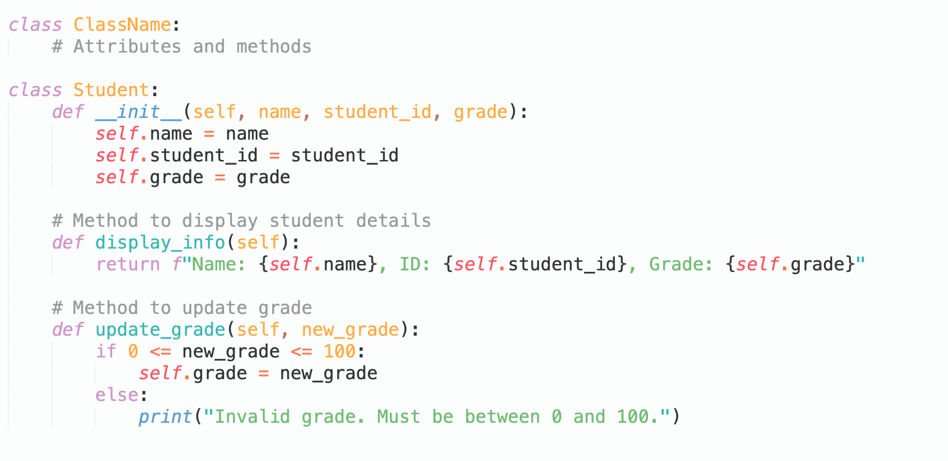
What is a Class?
A class is a user-defined data type that acts as a blueprint for creating objects.

Slide 8
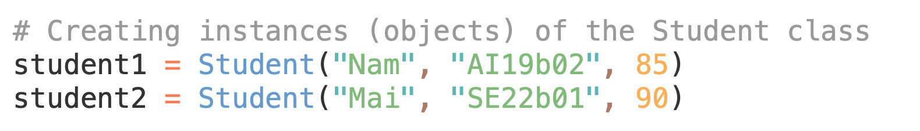
What is an Object?
An object is an instance of a class.

Slide 9
Practical Applications
Example:
Managing student records at FPT University:
Student class for student details.
Course class for course information.
Grade class for student grades.

Slide 10
What is the Object Lifecycle?
The Object Lifecycle consists of three main stages:
Creation: When an object is instantiated using the __init__ method.
Usage: When the object is used in a program (accessing attributes, calling methods).
Destruction: When the object is deleted or goes out of scope, triggering the __del__ method (if defined).

Slide 11
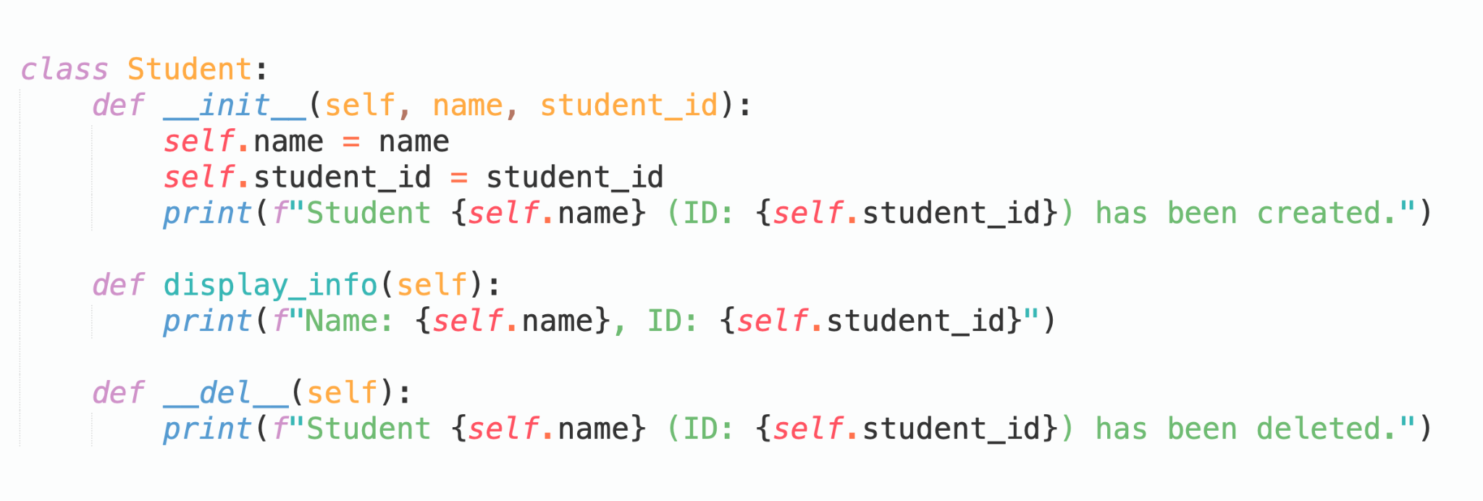
What is the Object Lifecycle?

Slide 12
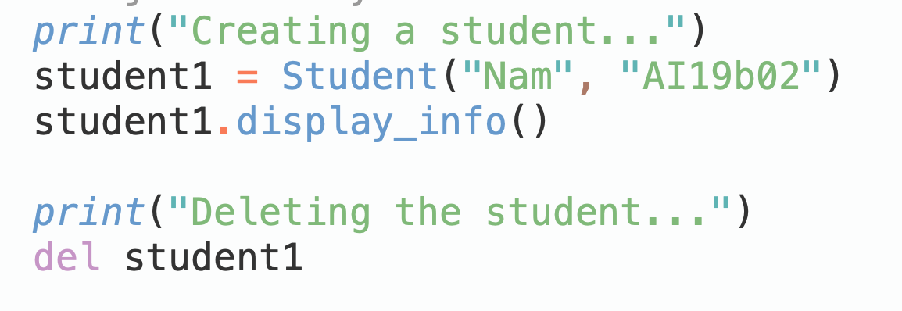
What is the Object Lifecycle?

Slide 13
What is Encapsulation?
Encapsulation means bundling data and methods into a single unit and restricting access to some of the object's components.

Slide 14
Access Modifiers
Public: Accessible everywhere.
Private: Accessible only within the class.
Protected: Accessible within the class and subclasses.

Slide 15
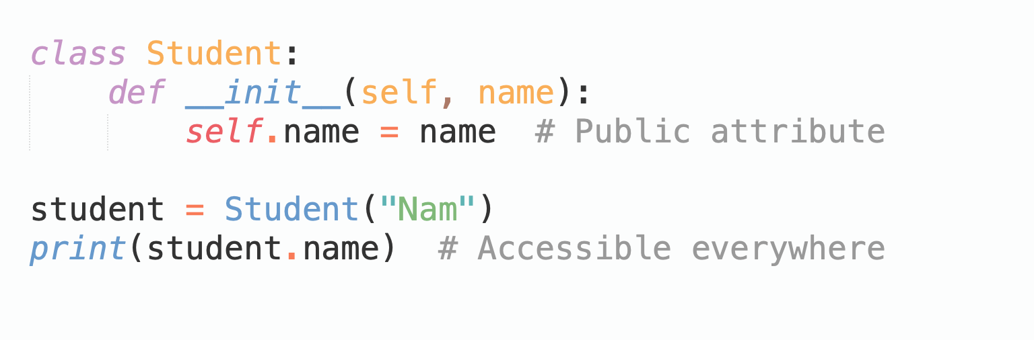
Access Modifiers
Public: Accessible everywhere.

Slide 16
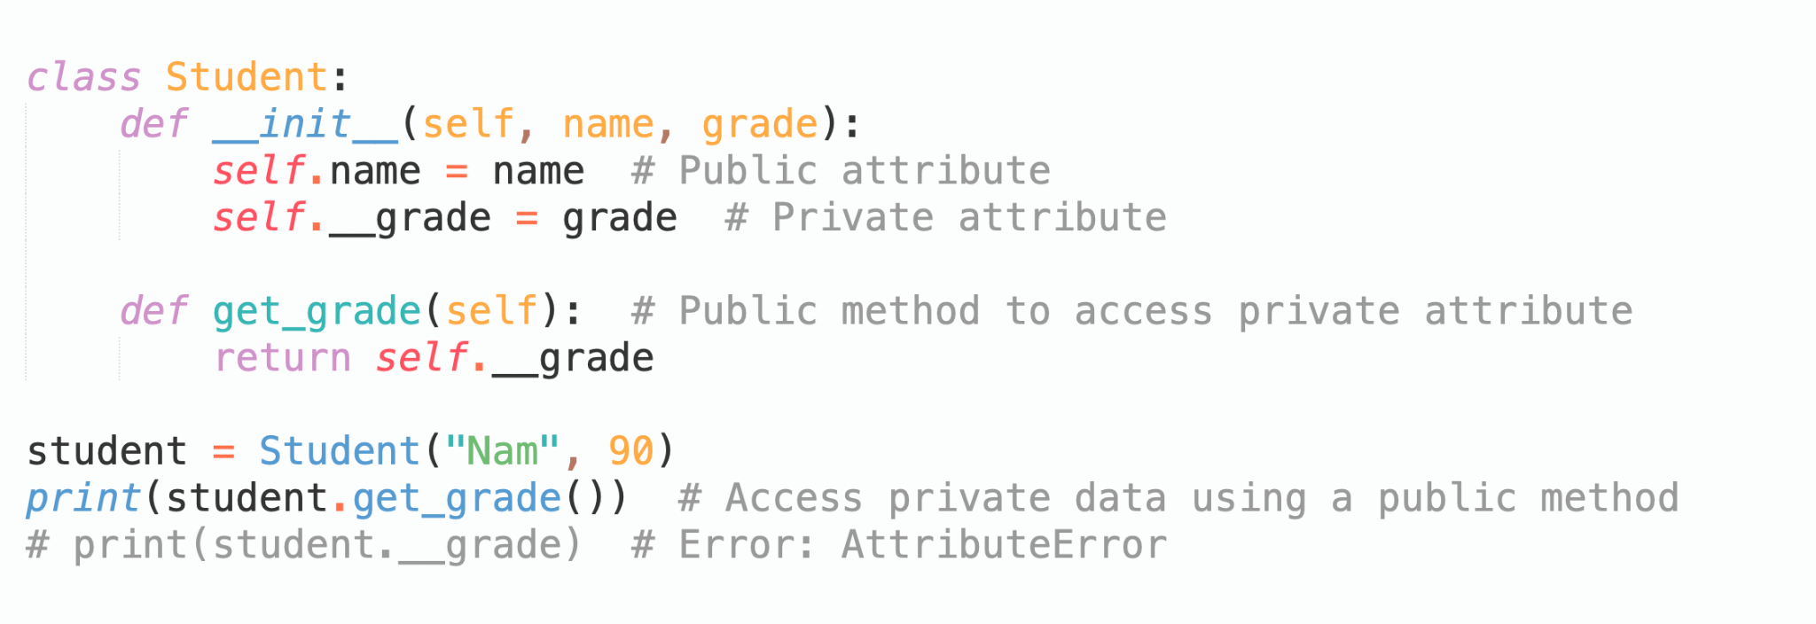
Access Modifiers
Private: Accessible only within the class.

Slide 17
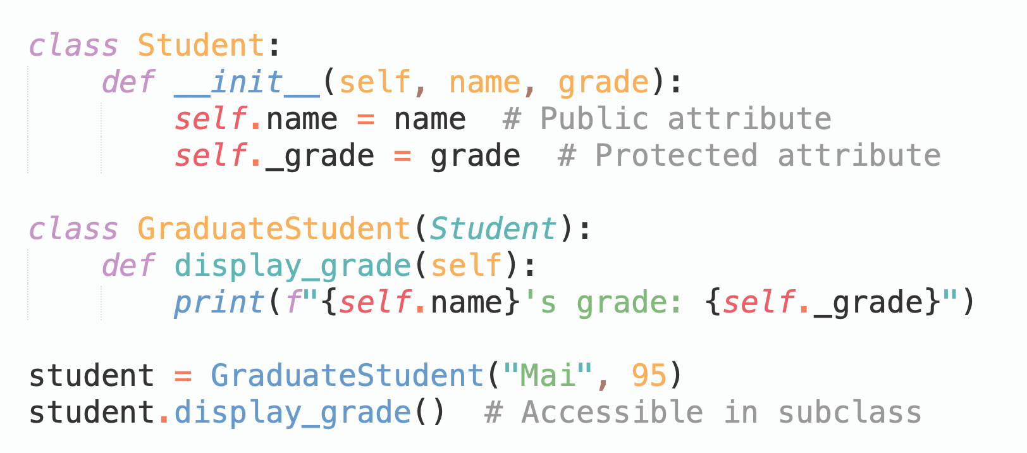
Access Modifiers
Protected: Accessible within the class and subclasses.

Slide 18
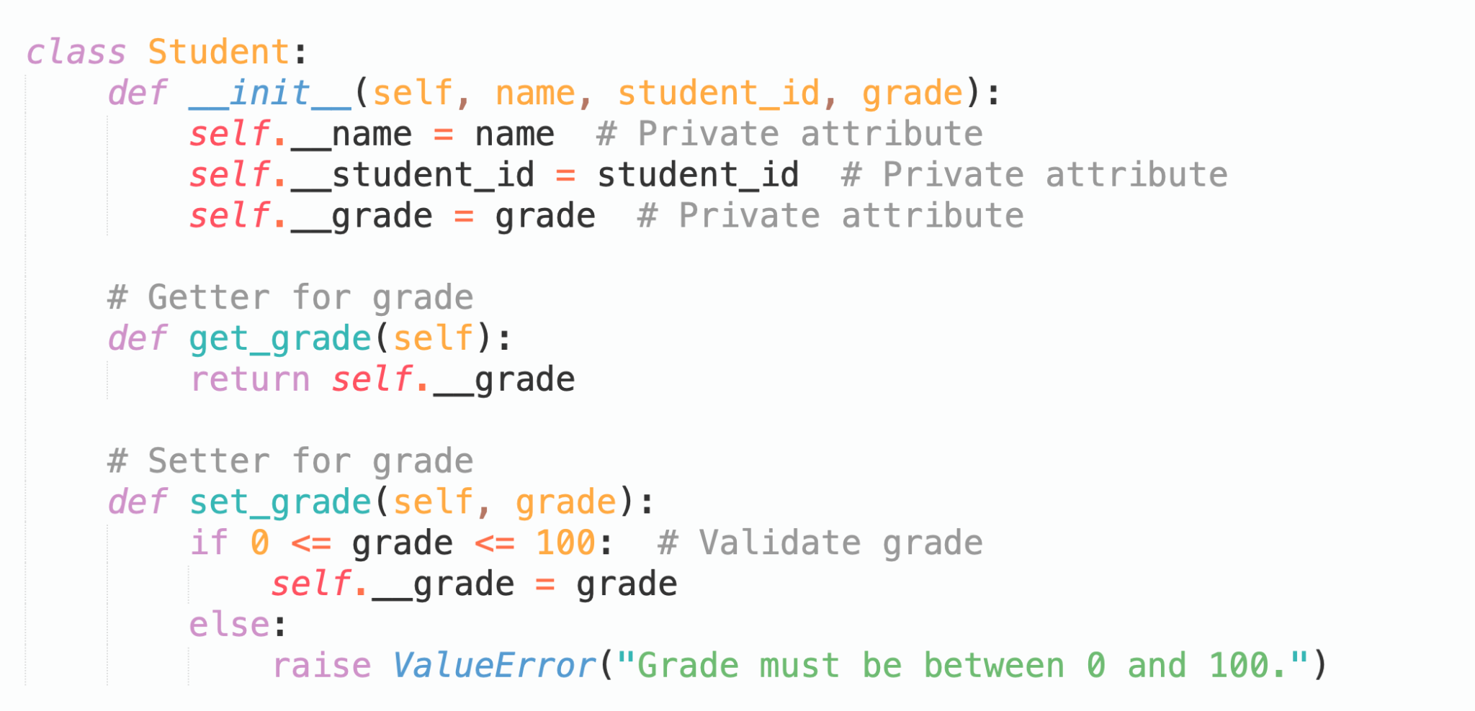
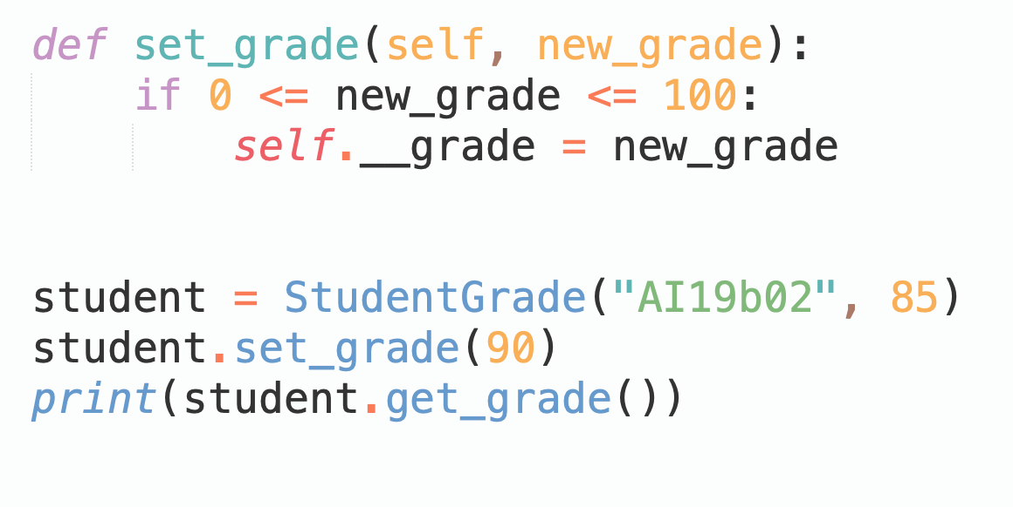
Getters and Setters
Modifying a student's grade securely.

Slide 19
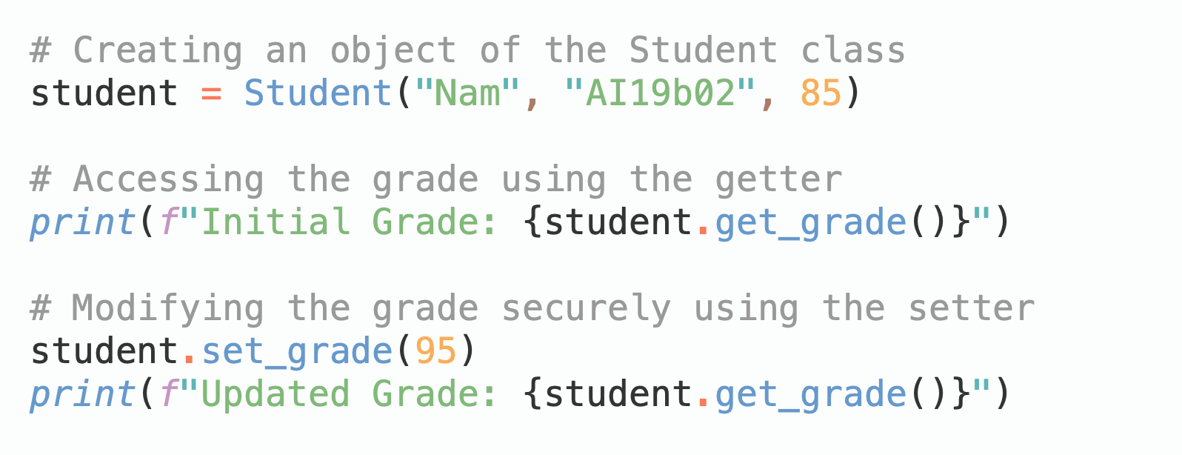
Getters and Setters
Modifying a student's grade securely.

Slide 20
What is Abstraction?
Abstraction focuses on hiding implementation details and exposing only the essential features to the user.

Slide 21
Examples of Abstraction
Example:
A StudentManagement system that abstracts the process of retrieving and managing student data.
→Users interact with a simplified interface (e.g., "Get Grades") without knowing how data is fetched or processed internally.

Slide 22
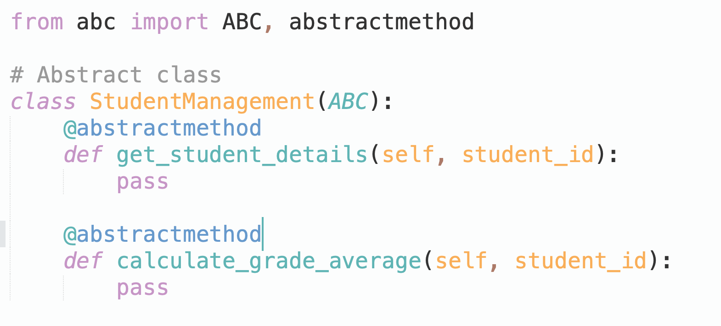
Implementing Abstraction
Use of abstract base classes (ABCs) with the abc module.

Slide 23
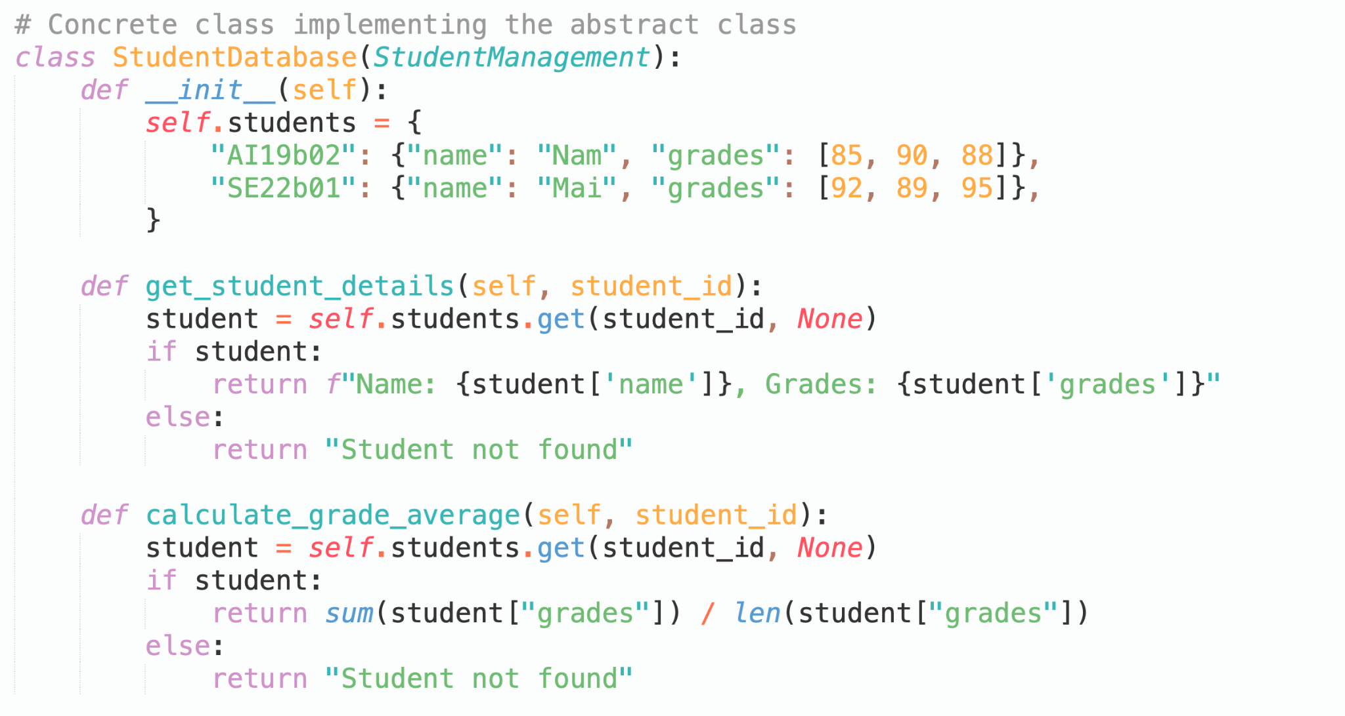
Using Abstraction

Slide 24
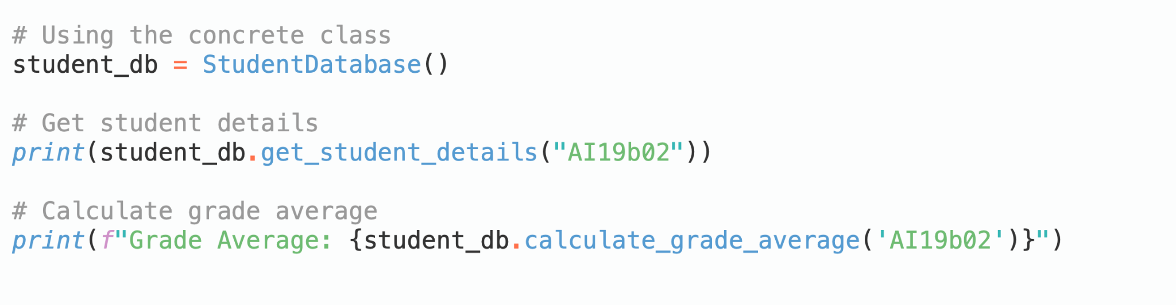
Using Abstraction

Slide 25
What is Modular Design?
Dividing a program into smaller modules to improve reusability and maintainability.
A student management system with modules for attendance, grades, and courses.

Slide 26
Benefits of Modular Design
Code reuse across multiple projects.
Easier debugging and testing.
Simplifies collaboration among developers.
Pie chart: Benefits distribution (50% reusability, 30% maintainability, 20% debugging).

Slide 27
Example: Modular Program
Code reuse across multiple projects.
Easier debugging and testing.
Simplifies collaboration among developers.
Pie chart: Benefits distribution (50% reusability, 30% maintainability, 20% debugging).

Slide 28
Key Concepts Recap
Classes and objects: Blueprints and instances.
Encapsulation: Protecting data and methods.
Abstraction: Hiding unnecessary details.
Modular Design: Breaking down problems into smaller, manageable parts.

Slide 29
Quiz: Basic Concepts
Question:
"What is the main difference between a class and an object?"
Options:
A. A class is an instance of an object.
B. A class is a blueprint; an object is an instance.
C. Objects contain data, while classes are data structures.

Slide 30
Discussion Prompt
How can encapsulation improve the security of student records at FPT University?

Slide 31
Recommended Reading
Resources:
Python documentation: https://docs.python.org
PY4E by Dr. Chuck: https://www.py4e.com

